Slide 1

NW.UnivariateForecaster
Documentation
numbworks, Iteration 7 (11-05-2018)

Slide 2
Iteration 7
Deployed to NonProd!
Let’s see how it goes ☺
Univariate
Research
Math
Observation 1 / Back-End
Observation 1 / CLF
Data Model
Observation 1 / Front-End
Data Retrieval / Storage
Added First Month Logic
In a sliding window of six months, the first month isn't usually considered, because it contains an un-usually low value that could lead to wrong estimations. If you want to consider it anyway, please set boolAllowFirstMonth = true.
Code
Observation 2 / Back-End
Unit Tests
Observation 2 / CLF
Observation 2 / Front-End
Cost Function
Next!
The next ML-related time slot will be dedicated to this.
I also got a book that talks only about «Time Series Analisys».
Multivariate
Research
Considering the first month
Math
[...]
Not considering the first month
Data Model
[...]

Slide 3
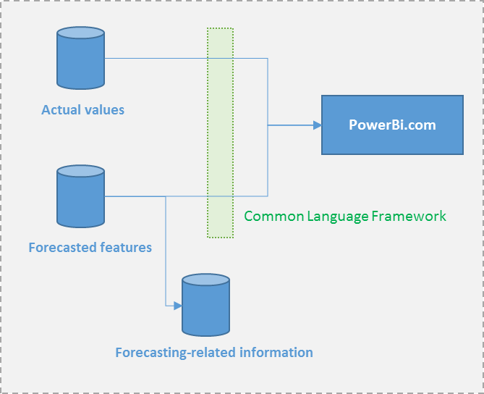
Iteration 7
Common Language Framework
It will allows us to easily pivot forecasted observations back to their original nomenclature, while keeping the advantages to store them in a generic and standardized table.
We can store in the tables as many Sliding Windows as we like.
The view will always consider only the most recent one for those criteria.
This allow us to do as many forecasting tasks as we like for the same criteria
PowerBi
The ‘ForecastingType’ field will enable us to switch between univariate and multivariate forecasted values
(different possible reporting scenarios our of the same table).

Slide 4
Iteration 6
It will look like this!
Data in the tables are non-production, but we’ll have production data soon.
The data model already support multivariate!
Up to six steps ahead, also if the suggested ones are max three.
Cost function
These will be used to improve the accuracy («cost function»). There will also be some views to monitor the accuracy (%) in real-time.
Common Language Framework
It will allows us to easily pivot forecasted observations back to their original nomenclature, while keeping the advantages to store them in a generic and standardized table.

Slide 5
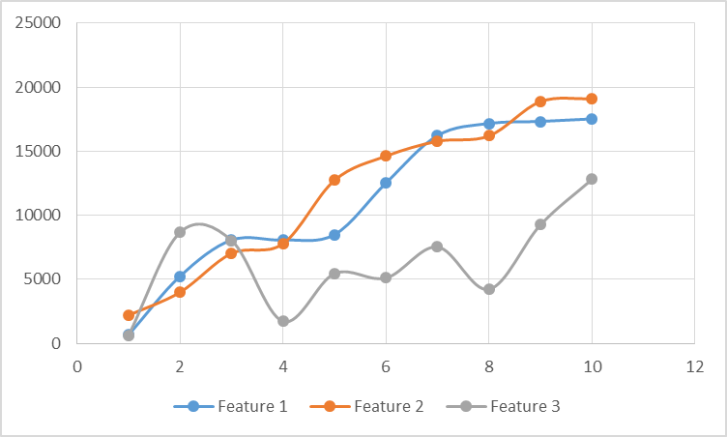
Iteration 6
Next month prediction
For ex., on the 14° of May, we are able to predict Managed Cloud Extended Cost for the month of June, for each deployment.
Research
Math
Observation 1 / Back-End
Observation 1 / CLF
ManagedCloudExtendedCost
mc-9113cb7d-bc75-4840-ba2d-0100f8525f30
Data Model
Observation 1 / Front-End
ML.TimeSeriesForecasting
ML.TimeSeriesForecasting is the first
machine technique (of hopefully many)
we’ll adopt, because it’s the most useful
for our dataset (data in time sequence).
Data Retrieval / Storage
Actual months
Code
Observation 2 / Back-End
Forecasted month
Unit Tests
Observation 2 / CLF
ML.TimeSeriesForecasting
Observation 2 / Front-End
Cost Function
1 2 3 4 5 6 7 8 9 10 11 12
A repository of observations
We are ready to add more observations very quickly, since most of the code is shared and generic.
Many visualization / interaction possibilities
Useful to spot trends, create hybrid observations, program the machine to data relationships for us.
Univariate
Research
Math
Univariate
1 step ahead
Data Model
Observation 1 / Back-End
Observation 1 / CLF
Multivariate
Data Retrieval / Storage
Observation 1 / Front-End
Multivariate
Up to 6 steps ahead
Code
Unit Tests
Cost Function

Slide 6
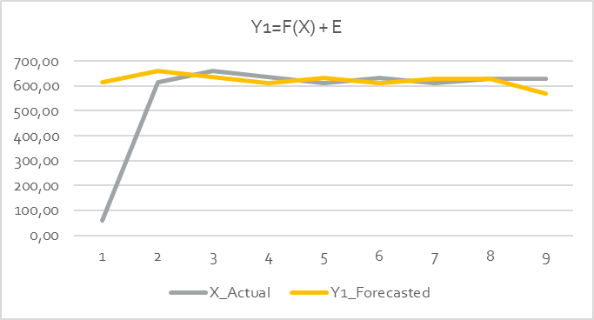
Iteration 5
Multivariate (up to 6 steps ahead)
Univariate (1 step ahead)
Sliding Window
PowerBi.com
Actual observations
Common
Language
Framework
View
Forecasting-related
information
Forecasted observations

Slide 7
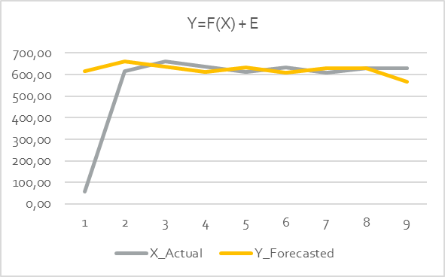
Iteration 4
Sliding Window
Actual values
PowerBi.com
Common Language Framework
Forecasted features
Forecasting-related information

Slide 8
Iteration 1
CSR
<TimeGrain> | FeatureDescriptor | FeatureValue
Incoming data
<TimeGrain> | PredictedValue | ActualValue
CSR-ML Cost Function
Repository of Features
Feature 1
Prediction 1
Feature Engineering
Feature 2
One-step ahead predictions
Multi-step ahead predictions
Prediction 2
”Simplify” data
CSR-ML Supervised Learning
CSR-ML
Feature 3
Prediction 3
1
[...]
[...]
”Combine” data
Feature x
Prediction x
CSR-ML
”Label” data
CSR-ML Unsupervised Learning
Identifying trends and
dependant variables.
Prediction Y1
CSR-ML
[...]
2
Prediction YX
Current Data
PowerBi.com
PowerBi.com
3

